Slide 1
Genetic Neuronal & Muscle Channelopathies
Dylan Brock, MD MA

Slide 2
DEFINITION
Heterogeneous group of disorders that result from the dysfunction of ion channels located in the membranes of all cells and many cellular organelles.
Location/distribution: May effect nearly any organ system
Sxs: May result in: seizures, movement disorders (ataxia, dyskinesias), paralysis, migraines, myotonia, neuropathies, myasthenic syndromes, pain or painlessness
Etiology: May be genetic (covered here) OR acquired (i.e., autoimmune)
Nomenclature: channelopathies vs synaptopathies vs transportopathies
Notes:
More than 400 ion channel genes have been identified
Different mutations can occur in the same gene and result in different phenotypes
Mutations in the different genes can result in the same phenotype
Typically many different subunits to compose of 1 channel - each subunit is encoded by different genes

Slide 3
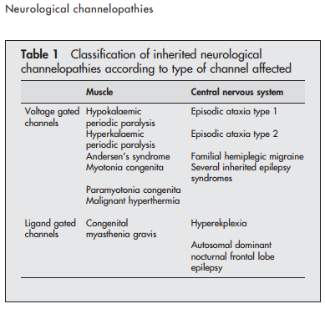
Channelopathies: Ligand gated & Voltage-gated channels
Notes:
Ion channels: simply gated pores that allow the passive flow of ions down their gradient.
Ligand gated: channels that are activated by the binding of respective agonists – then lead to the flux of ions
Ex: GABA and glutamate
Voltage gated: activated and inactivated by CHANGES in membrane voltage

Slide 4
Channelopathies
Ligand-gated
Notes:
Ion channels: simply gated pores that allow the passive flow of ions down their gradient.
Ligand gated: channels that are activated by the binding of respective agonists – then lead to the flux of ions
Ex: GABA and glutamate
Voltage gated: activated and inactivated by CHANGES in membrane voltage

Slide 5
Channelopathies
Voltage-gated
Notes:
Would be nice to demonstrate with pictures
Ligand gated: channels that are activated by the binding of respective agonists – then lead to the flux of ions
Ex: GABA and glutamate
Voltage gated: activated and inactivated by CHANGES in membrane voltage

Slide 6
Channelopathies
Voltage-gated
Notes:
Would be nice to demonstrate with pictures
Ligand gated: channels that are activated by the binding of respective agonists – then lead to the flux of ions
Ex: GABA and glutamate
Voltage gated: activated and inactivated by CHANGES in membrane voltage

Slide 7
Channelopathies
Voltage-gated
* Missense mutations in channelopathy genes may affect any location (often pore, transmembrane portion) or any phase of function
Notes:
Would be nice to demonstrate with pictures
Ligand gated: channels that are activated by the binding of respective agonists – then lead to the flux of ions
Ex: GABA and glutamate
Voltage gated: activated and inactivated by CHANGES in membrane voltage

Slide 8
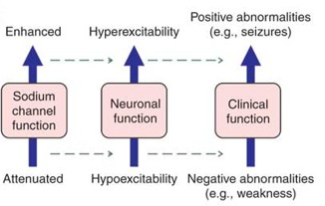
Channelopathies
Notes:
Would be nice to demonstrate with pictures
Ligand gated: channels that are activated by the binding of respective agonists – then lead to the flux of ions
Ex: GABA and glutamate
Voltage gated: activated and inactivated by CHANGES in membrane voltage

Slide 9
Channelopathies
Mutations may be gain of function OR loss of function.
Genotype/phenotype correlations are not always consistent.
Notes:
Would be nice to demonstrate with pictures
Ligand gated: channels that are activated by the binding of respective agonists – then lead to the flux of ions
Ex: GABA and glutamate
Voltage gated: activated and inactivated by CHANGES in membrane voltage

Slide 10
The Ubiquity of Channelopathies

Slide 11
Cardiac
Systemic Channelopathies
Respiratory

Slide 12
Endocrine
Systemic Channelopathies
Renal
Bartter syndrome
Liddle syndrome
Focal segmental glomerulosclerosis
Polycystic kidney disease
Nephrogenic diabetes insipidus
Pseudohypoaldosteronism
Permanent neonatal diabetes mellitus
Transient neonatal diabetes mellitus
Familial hyperinsulinemic hypoglycemia

Slide 13
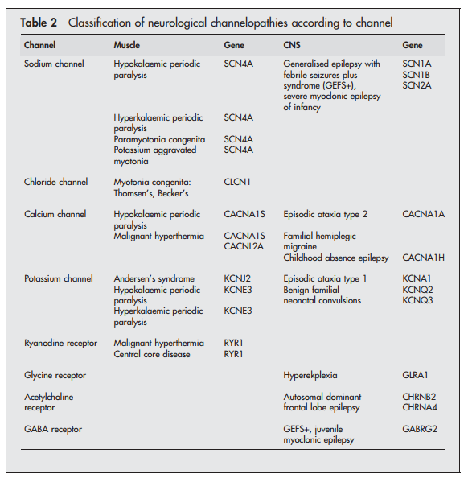
Nervous System Channelopathies

Slide 14
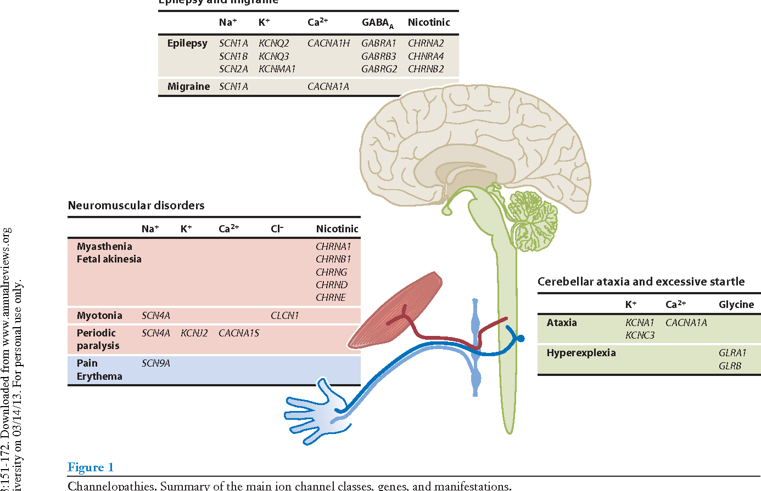
Nervous System Channelopathies
Epilepsy & Migraine

Slide 15
MUSCLE CHANNELOPATHIES
Myotonia congenita
Paramyotonia congenita
Congenital myasthenic syndrome
RYR1 Myopathy
(Central core disease / malignant hypothermia)
Hyperkalemic periodic paralysis
Hypokalemic periodic paralysis
Notes:
Channelopathies were first identified in skeletal muscle disorders
Congenital myasthenic syndrome: heterogenous group of disorders of the NMJ that can arise from defects in presynaptic, synaptic, or postsynaptic. Most are postsynaptic mutations of nAChR
Hyperkalemic periodic paralysis: AD, attacks of muscle weakness and mild myotonia with concomitant transient hyperkalemia; gain of function mutation in SCN4A

Slide 16
MUSCLE CHANNELOPATHIES
Myotonia congenita
Paramyotonia congenita
Congenital myasthenic syndrome
RYR1 Myopathy
(Central core disease / malignant hypothermia)
Hyperkalemic periodic paralysis
Hypokalemic periodic paralysis
Stiffness
Weakness
Paralysis
Notes:
Channelopathies were first identified in skeletal muscle disorders
Congenital myasthenic syndrome: heterogenous group of disorders of the NMJ that can arise from defects in presynaptic, synaptic, or postsynaptic. Most are postsynaptic mutations of nAChR
Hyperkalemic periodic paralysis: AD, attacks of muscle weakness and mild myotonia with concomitant transient hyperkalemia; gain of function mutation in SCN4A

Slide 17
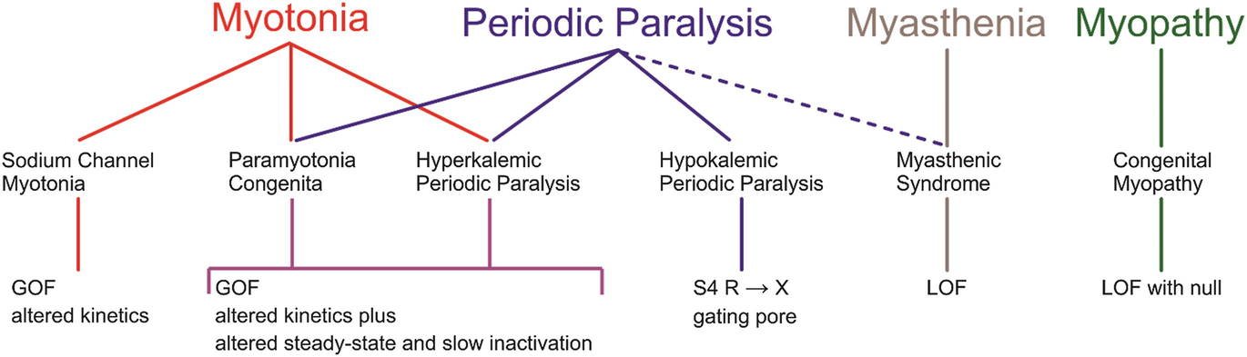
Muscle involvement
Notes:
On the left is muscle hyperexcitability – difficulty repolarizing the cell as in a chloride mutation
On the right is muscle hypoexcitability – cells are hyperpolarized making it difficult to contract

Slide 18
Muscle involvement
Notes:
On the left is muscle hyperexcitability – difficulty repolarizing the cell as in a chloride mutation
On the right is muscle hypoexcitability – cells are hyperpolarized making it difficult to contract

Slide 19
Case 1
CC: 10 y/o boy presenting with muscle stiffness on initiation of movement
HPI: Examples include feeling like his feet are stuck to the ground when he tries to run on the soccer field. No eye, swallowing, or breathing involvement
Normal development
Exam: Normal strength but warm up phenomenon present. Sustained contraction of triceps with percussion.
Workup: MRI brain normal
Notes:
Able to cover it up, but standing up, pausing, and then continuing
Minor difficulty in letting go of large objects but not small objects
Symptoms began in middle school
No breathing, swallowing, ocular involvement
What does he have?
What is the differential for that?
-myotonic dystrophy versus paramyotonia congenita
946729

Slide 20

Case 1
https://www.youtube.com/watch?v=AnVv0RkiG4U
Notes:
Able to cover it up, but standing up, pausing, and then continuing
Minor difficulty in letting go of large objects but not small objects
Symptoms began in middle school
No breathing, swallowing, ocular involvement
What does he have?
What is the differential for that?
-myotonic dystrophy versus paramyotonia congenita
946729

Slide 21
Myotonia Congenita
Epidemiology:
Estimated worldwide prevalence: 0.2-7.3 per 100,000
Symptoms typically present in childhood
Men > women
Subtypes:
Thomsen: autosomal dominant
Becker: autosomal recessive (more severe)
Clinical presentation:
Stiffness with initiation of movement
Warm-up phenomenon
Generalized muscle hypertrophy
Worse in cold environments
Notes:
No clear clinical distinction between Thomsen and Becker clinical phenotypes.
The dominant form tends to present earlier
The recessive form tends to be more severe
Results from delayed relaxation and thus sustained electrical activity in muscle. Mutation in CLCN1 – loss of function of chloride channel, which contributes to repolarization of muscle

Slide 22
Non-Dystrophic Myotonias
Non-dystrophic myotonias include:
Myotonia congenita (AD or AR)
Paramyotonia congenita (AD)
Worsens with sustained exercise → ‘paradoxical’ myotonia → paramyotonia
Sodium channel myotonias (AD)
Typically present in the first two decades of life with muscle stiffness in the absence of severe fixed weakness or muscle wasting (contrasted with muscular dystrophies)
No multisystem involvement
Notes:
No clear clinical distinction between Thomsen and Becker clinical phenotypes.
The dominant form tends to present earlier
The recessive form tends to be more severe
Results from delayed relaxation and thus sustained electrical activity in muscle. Mutation in CLCN1 – loss of function of chloride channel, which contributes to repolarization of muscle

Slide 23
Myotonia Congenita
Pathophysiology:
Impaired relaxation of skeletal muscle after sudden voluntary contraction
Presentation (in children):
Muscle stiffness /cramps
May have funny gait, frequent falls, and below average running compared to peers
Can also have ankle contractures
Rarely scoliosis
Episodic neonatal laryngospasm
Mechanisms/Channel:
CLCN1 (Chloride)
Treatment:
Avoidance of cold temperatures
Acetazolamide
Sodium channel blockers – tocainimide or mexitetine
Carbamazepine
Prognosis:
Symptoms tend to improve with age
No change in life expectancy
Notes:
>200 mutations have been identified
CLCN1: important role in membrane repolarization
Problem: continued muscle contraction several seconds after the nerve impulse has abated

Slide 24
CLCN1
Notes:
difficulty repolarizing
This particular channel is a dimer
Responsible for resting membrane potential
Defect leads to poor chloride conductance through the channel

Slide 25
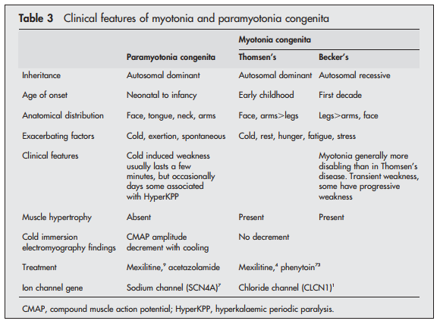
Myotonia (CLCN1) & Paramyotonia (SCN4A)
Notes:
Channelopathies were first identified in skeletal muscle disorders
Congenital myasthenic syndrome: heterogenous group of disorders of the NMJ that can arise from defects in presynaptic, synaptic, or postsynaptic. Most are postsynaptic mutations of nAChR
Hyperkalemic periodic paralysis: AD, attacks of muscle weakness and mild myotonia with concomitant transient hyperkalemia; gain of function mutation in SCN4A

Slide 26
Case 2
CC: 10 y/o boy presenting with weakness on awakening this morning.
HPI: When he woke at 8am, he was unable to get out of bed. Strength gradually returned over 3-4 hrs. It is now normal. No recent strenuous activity. Ate pizza and chips for dinner.
Exam: 9hrs after symptom onset:
Completely normal
Workup:
CBC normal
CMP notable for [K⁺] of 2.8
CK normal

Slide 27
Hypokalemic Periodic Paralysis
Epidemiology:
Most common form of periodic paralysis
Autosomal dominant inheritance
Seen in 1:100,000
Clinical presentation:
Presents before age 20
Several episodes per month
Recurrent attacks of flaccid weakness, lasting minutes to hours to days, with spontaneous full recovery
Serum [K⁺] <3.5 mmol/L
(typically <3mmol/L)
Provoked by:
Carbohydrate-rich meals
Rest after period of vigorous exercise
Exposure to cold
Emotional stress
Meds: insulin, B-agonists, steroids
Notes:
Heart and lungs are unlikely to be involved

Slide 28
Hypokalemic Periodic Paralysis
Pathophysiology:
Transient inability to excite the muscle due to prolonged depolarization of the myocyte
Mechanisms:
CACNA1S – 70%
SCN4A
Treatment:
Avoidance of triggers (Tx: small, frequent meals, no carb loads, low salt)
Potassium supplements
Acetazolamide or potassium sparing diuretics
Dichlorphenamide
Prognosis:
Attack frequency decreases with age
Can develop limb-girdle weakness
Notes:
Acetazolamide – helpful in 50% of patients with CACNA1S
Topiramate is known to have carbonic anhydrase activity – could it help?
The metabolic acidosis seen in CA inhibitors concomittantly increase plasma potassium

Slide 29
Hypokalemic Periodic Paralysis
Acetazolamide in the treatment of muscle channelopathies (Matthew et all 2011):
46% of the total patient cohort (34 of 74) reported benefit from acetazolamide.
Greater chance of benefit in patients with mutations in CACNA1S (31 responded of 55 total) than in those with mutations in SCN4A (3 responded of 19 total)
Notes:
Acetazolamide – helpful in 50% of patients with CACNA1S
Topiramate is known to have carbonic anhydrase activity – could it help?
The metabolic acidosis seen in CA inhibitors concomittantly increase plasma potassium

Slide 30
Hypokalemic Periodic Paralysis CACNA1S
CACNA1S gene:
Encodes alpha-1s subunit for L-type voltage-gated calcium channel
Channels containing the CACNA1S protein are highly expressed in skeletal muscles.
Calcium channels made with the CACNA1S subunit are located in the outer membrane of muscle cells → transmit electrical signals from the cell surface to inside the cell.
Interact with another type of calcium channel called ryanodine receptor 1 channels → triggering RYR1 channels to open → intracellular calcium release → muscle contraction
(Also associated with malignant hypothermia)
Notes:
Acetazolamide – helpful in 50% of patients with CACNA1S
Topiramate is known to have carbonic anhydrase activity – could it help?
The metabolic acidosis seen in CA inhibitors concomittantly increase plasma potassium

Slide 31
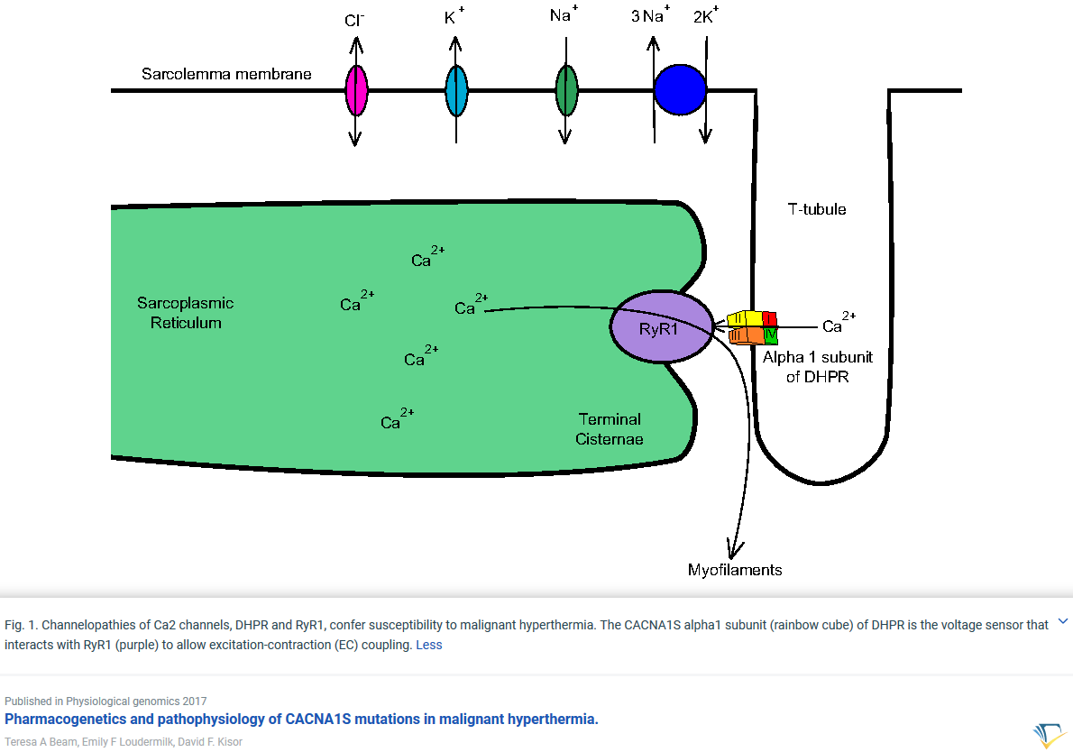
Hypokalemic Periodic Paralysis CACNA1S
Notes:
Acetazolamide – helpful in 50% of patients with CACNA1S
Topiramate is known to have carbonic anhydrase activity – could it help?
The metabolic acidosis seen in CA inhibitors concomittantly increase plasma potassium

Slide 32
CACNA1s SCN4A
Notes:
Why is the potassium LOW extracellularly if the genetic change is in the calcium and sodium channels?
Mystery as to why potassium channels are affected by mutations in either gene above.
There is an inward cation leak, which leads to low extracellular potassium and thus aberrant depolarization
Likely there is a calcium activated potassium channel that is affected by these mutations.
Cells are hyperpolarized, making it very difficult to depolarize

Slide 33
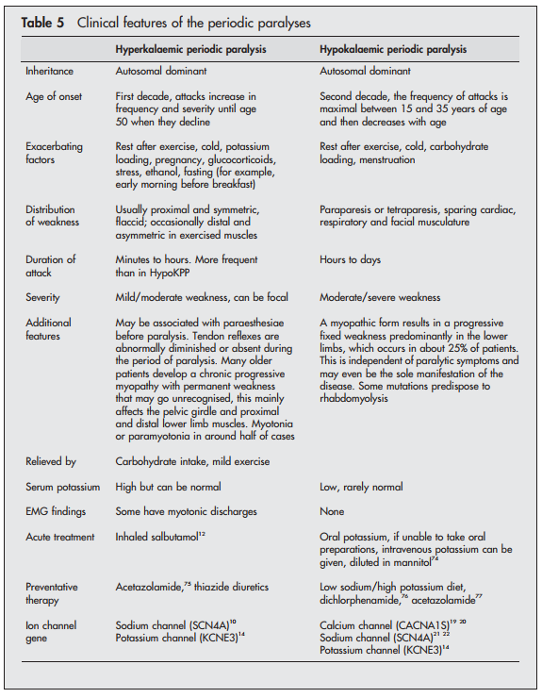
Notes:
Why is the potassium LOW extracellularly if the genetic change is in the calcium and sodium channels?
Mystery as to why potassium channels are affected by mutations in either gene above.
There is an inward cation leak, which leads to low extracellular potassium and thus aberrant depolarization
Likely there is a calcium activated potassium channel that is affected by these mutations.
Cells are hyperpolarized, making it very difficult to depolarize

Slide 34
Andersen-Tawil Syndrome
Genetics: KCNJ2 or KCNJ5
Triad of:
Channelopathy of dyskalemia
Dysmorphic features: craniofacial, dental, skeletal
Cardiac arrhythmias: delayed cardiac repolarization
Notes:
Dyskalemia: hyper or hypokalemia

Slide 35
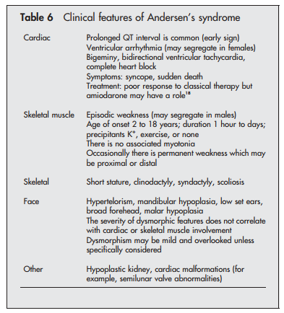
Andersen-Tawil Syndrome
Notes:
Dyskalemia: hyper or hypokalemia

Slide 36
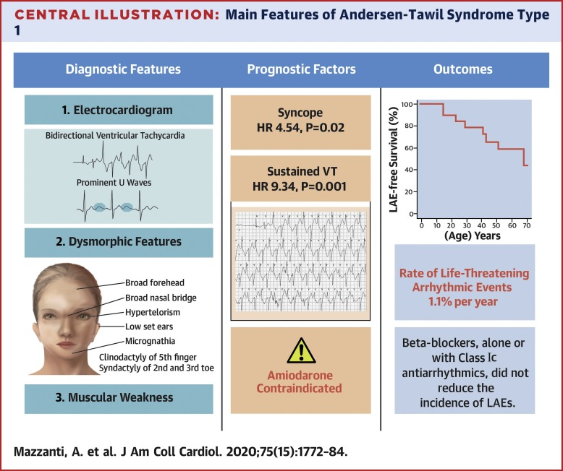
Andersen-Tawil Syndrome
Notes:
Dyskalemia: hyper or hypokalemia

Slide 37
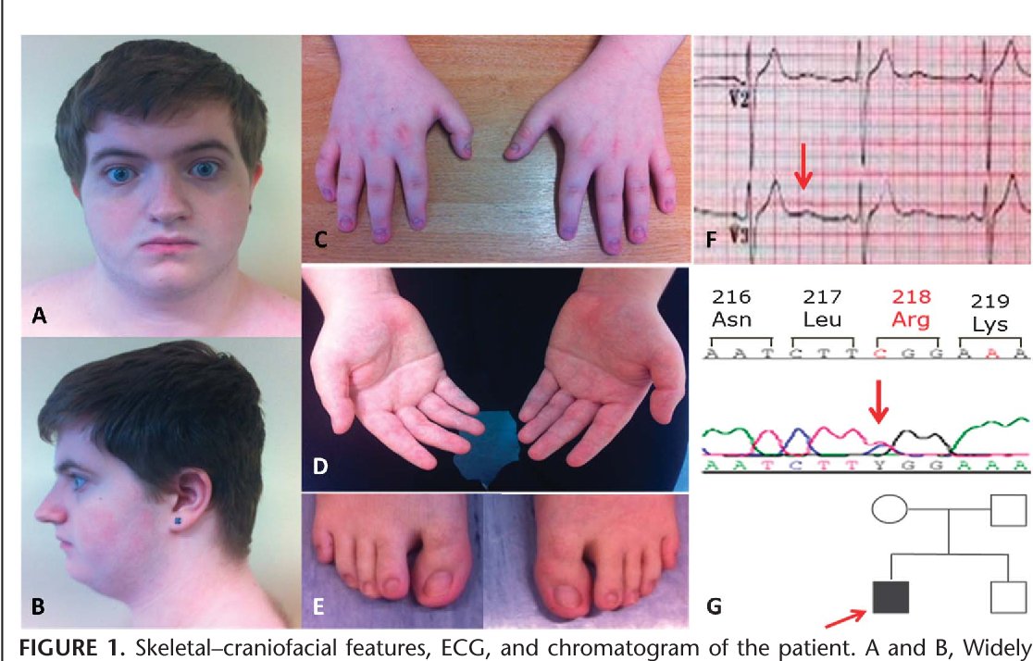
Andersen-Tawil Syndrome
Notes:
Dyskalemia: hyper or hypokalemia

Slide 38
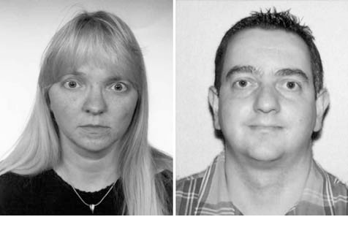
Andersen-Tawil Syndrome
Notes:
Dyskalemia: hyper or hypokalemia

Slide 39
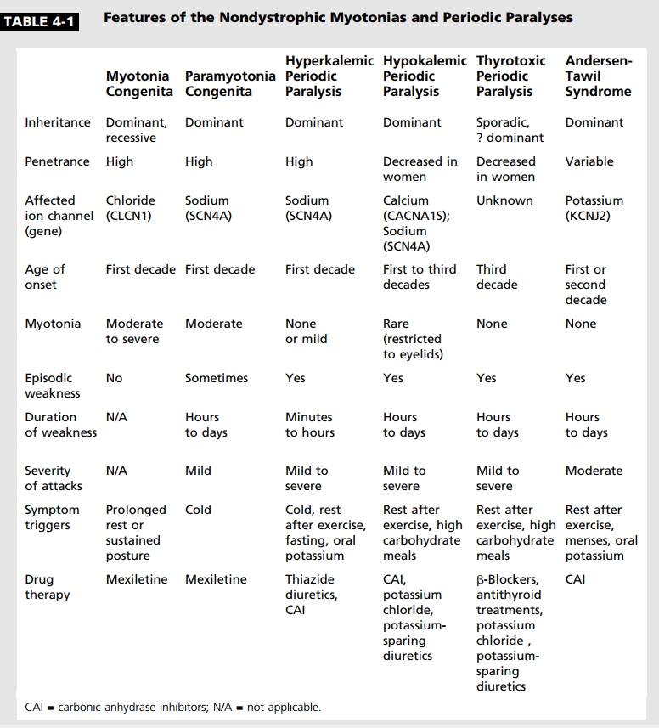
Muscle Channelopathies
Hyperkalemic periodic paralysis
Hypokalemic periodic paralysis
Congenital myasthenic syndrome
Myotonia congenita
Paramyotonia congenita
Central core disease
Notes:
Channelopathies were first identified in skeletal muscle disorders
Congenital myasthenic syndrome: heterogenous group of disorders of the NMJ that can arise from defects in presynaptic, synaptic, or postsynaptic. Most are postsynaptic mutations of nAChR
Hyperkalemic periodic paralysis: AD, attacks of muscle weakness and mild myotonia with concomitant transient hyperkalemia; gain of function mutation in SCN4A

Slide 40
Neuronal Channelopathies
Benign familial neonatal/infantile epilepsy
Early infantile epileptic encephalopathy
Generalized epilepsy with febrile seizures plus
Generalized epilepsy with paroxysmal dyskinesias
Childhood absence epilepsy
Juvenile myoclonic epilepsy
Nocturnal frontal lobe epilepsy, types 1, 3, 4, and 5
Dravet syndrome
Familial hemiplegic migraine, types 1, 2, and 3
Episodic ataxia, types 1, 2, and 5
Spinocerebellar ataxia, types 6 and 13
Familial paroxysmal dyskinesias
Hyperekplexia or stiff baby syndrome
Notes:
Dravet: SCN1A or GABRG2 (encodes GABA receptor) – both lead to reduced excitability of GABAergic neurons leading to brain hyper-excitability. The Nav1.1 channel is preferentially expressed in GABAergic neurons

Slide 41
Neuronal Channelopathies
Benign familial neonatal/infantile epilepsy
Early infantile epileptic encephalopathy
Generalized epilepsy with febrile seizures plus
Generalized epilepsy with paroxysmal dyskinesias
Childhood absence epilepsy
Juvenile myoclonic epilepsy
Nocturnal frontal lobe epilepsy, types 1, 3, 4, and 5
Dravet syndrome
Familial hemiplegic migraine, types 1, 2, and 3
Episodic ataxia, types 1, 2, and 5
Spinocerebellar ataxia, types 6 and 13
Familial paroxysmal dyskinesias
Hyperekplexia or stiff baby syndrome
Epilepsy
Migraine
Movement disorders
Notes:
Dravet: SCN1A or GABRG2 (encodes GABA receptor) – both lead to reduced excitability of GABAergic neurons leading to brain hyper-excitability. The Nav1.1 channel is preferentially expressed in GABAergic neurons

Slide 42
Case 3
CC: 17 y/o girl who presents with 1 day of right sided weakness, aphasia, and encephalopathy
HPI: Reported “feeling a migraine coming on” the night before these symptoms began. Initially partially responsive to migraine cocktail before worsening again. Now with fever in ED.
Has similar, although less severe, symptoms every 5-6 weeks
Had several seizures as an infant. Freshman in high school.
Exam: Somnolent. Unable to follow commands. Only moans. Right hemiparesis face/arm > leg. Upgoing right toe.
Work-up:
CSF with 2 cells, R8, P122, G78, MEP neg.
CTH/CTA normal.
MRI with ribboning of restricted diffusion along the L hemispheric cortex with decreased perfusion in associated vessels.
Notes:
Not all family members have to have cerebellar signs

Slide 43
Familial hemiplegic migraine
International Headache Classification
Migraine with aura including motor weakness AND at least 1 1st or 2nd degree relative with migraine with aura including weakness
Diagnostic criteria:
Meets criteria for migraine
Aura with both of the following
Fully reversible motor weakness
Fully reversible visual, sensory, or speech symptoms
Subtypes:
FMH1: CACNA1A
FMH2: ATP1A2
FMH3: SCN1A
Other:
SLC1A3
SLC4A4
Notes:
ATP1A2: Na-K ATPase pump
SLC: glutamate transporters that have also been associated with episodic ataxia and renal tubular acidosis

Slide 44
Familial hemiplegic migraine
Epidemiology:
Autosomal dominant inheritance
Begin 1st-2nd decade of life
Clinical presentation:
Most patients have migraine with aura
Typical: Aura of hemiparesis PLUS sensory, language, visual disturbance followed by headache
More severe: Confusion, coma, fever, hemiplegia lasting days to weeks > seizures
33% in FHM1; 15% FHM2
With cerebellar signs: ataxia and/or nystagmus
Workup:
CSF: May show lymphocytic pleocytosis
MRI: acutely edema of the involved hemisphere AND narrowing of associated vessels; chronically the hemisphere can be atrophic
Notes:
The severe attacks are mostly in people <20 years of age – our population
First symptoms of the disease in 20%
Triggered by a mild head trauma in 10% or emotional stress

Slide 45
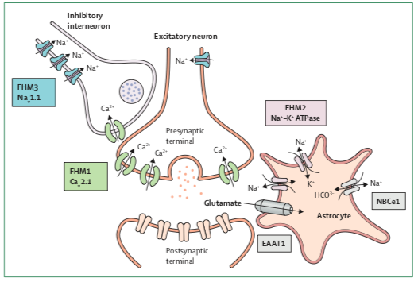
Pathophysiology
Notes:
What is cortical spreading depression? Brief neuronal excitation, which initiates a depolarization wave that moves across the cortex at 3-5 mm/min and is followed by prolonged inhibition of neuronal activity
The inhibitory neuron hyperpolarizes the cell
Presynaptic terminal = axon terminal
FMH1: gain of function on calcium channel > increased NT release
Knock-in mice with CACNA1A mutations > lowered threshold for CSD, increased probability of glutamate release, altered GABA circuits
FMH2: loss of function of the ATPase > reduced potassium/glutamate uptake > very slowed recovery
FMH3: not really known, but overall decrease inhibitory function

Slide 46
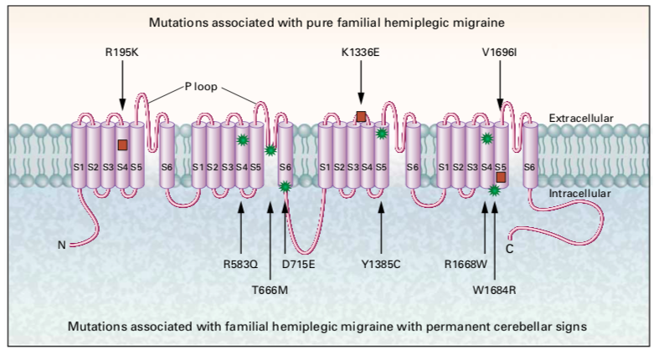
FHM1: CACNA1A

Slide 47
CACNA1A
Found on chromosome 19
Encodes the pore-forming alpha-1 subunit of P/Q type voltage-gated calcium channel Cav2.1
Heterogeneous presentations:
FHM1: gain-of-function which increases channel activity, synaptic transmission, and susceptibility to cortical spreading depression
May produce attacks triggered by fever or mild head trauma.
Severe presentation with p.Ser218Leu mutation → “early seizures and cerebral edema after trivial head trauma” (ESCEATHT)
EA2: loss of function which results in decreased calcium currents. As this channel is highly expressed in cerebellar Purkinje cells, this leads to cerebellar dysfunction
SCA6: CAG repeat expansion leading to gain of function, mutant channels are incompletely degraded and build up in the cell
Paroxysmal tonic upward gaze
ASD/ID?
Notes:
Also seen in alternating hemiplegia of childhood
Autosomal dominant subtype of migraine with aura
1st de novo CACNA1A mutation of FHM was reported in 2000
Accounts for 50% of patients with FHM

Slide 48
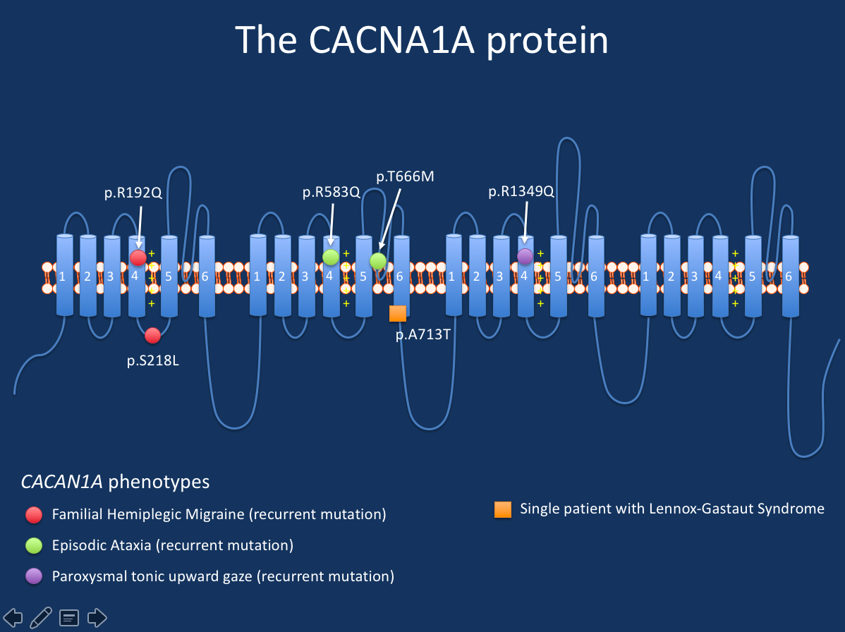
FHM1: CACNA1A
Notes:
Phenotypes
Summary. In brief, CACNA1A is usually associated with three main familial phenotypes, which can sometimes overlap. These three main phenotypes are familial episodic ataxias, familial spinocerebellar ataxias, and familial hemiplegic migraines. The reason why I am distinguishing episodic and spinocerebellar ataxias is due to the fact that the disease presentation in these conditions is entirely different. Episodic ataxias lead to brief, recurrent, non-progressive episodes of lack of balance, whereas spinocerebellar ataxias are chronic, progressive diseases that are often associated with imaging findings (cerebellar atrophy). Historically, CACNA1A was identified in familial hemiplegic migraine and episodic ataxia at the same time in 1996. The discovery in spinocerebellar ataxia followed soon afterwards in 1997. Here are the various CACNA1A-related phenotypes.
Familial hemiplegic migraine 1 (FHM1). Familial hemiplegic migraine was one of the first phenotypes to be associated with mutations in CACNA1A. FHM is characterized by migraines with aura that is associated with weakness on one side of the body. Patients with FHM due to CACNA1A mutations can have loss of consciousness or even coma in association with mild head trauma. In some families, the FHM phenotype may overlap with other CACNA1A-related phenotypes.
Episodic ataxia 2 (EA2). Episodic ataxia type is characterized by attacks of gait ataxia, poor balance, nausea, vomiting, and sometimes particular eye movement disorders that is referred to as oscillopsia. Patient with episodic ataxia can present in childhood or adolescence and the attacks can last between hours and a few days. Sometimes, attacks are set off by triggers such as physical physical stress, infection, fever, heat, exertion, caffeine, or alcohol. The attacks can be associated with various neurological symptoms, occasionally even with the hemiplegic symptoms seen in FHM. Between the attacks, patients usually do not have symptoms. However, more recent studies suggest that up to 50% of patients may eventually develop chronic neurological features such as nystagmus or cerebellar atrophy.
Spinocerebellar ataxia 6 (SCA6). Spinocerebellar ataxia is a slowly progressive neurological disorder that is characterized by progressive limb and gait cerebellar ataxia. Often, patients also develop other neurological symptoms such as dysmetria in the upper extremities, intention tremor, dysarthria, and various oculomotor symptoms such as nystagmus or diplopia. The bulbar signs, especially dysarthria, can be the presenting sign in up to 10% of patients. Patients usually present with symptoms in adulthood, usually in their 40s and 50s.
Paroxysmal tonic upward gaze. Some novel CACNA1A phenotypes are still being discovered given the increasing use of genetic testing. For example, individuals with de novo missense alterations in CACNA1A with paroxysmal tonic upward gaze in the neonatal period or early infancy were recently described by Blumkin and collaborators. In addition to these eye movement abnormalities, patients had developmental delays and ataxia, nystagmus, dysarthria, tremor, dysmetria, and seizures
The epilepsies. There is some difficulty in fully understanding the entire spectrum of seizure disorders caused by mutations in CACNA1A. Absence seizures appear to be a relatively common feature, found in up to 10% of patients in EA2 families. Generalized EEG features are a common finding. However, despite the known association with epilepsy, some earlier reports need to be viewed with caution. For example, OMIM implies a definite involvement in Idiopathic/Genetic Generalized Epilepsy (IGE/GGE) based on an older association study that has not been validated in more recent studies. CACNA1A can be a deceiving gene, and rare population variants in this gene can be found that may be initially interpreted as causative. A study suggesting variants in CACNA1A as modifiers in Dravet Syndrome should be interpreted critically.
Intellectual disability, autism. The publication by Damaj and collaborators also identifies individual patients with ADHD, intellectual disability and autism carrying CACNA1A mutations. However, other CACNA1A phenotypes were also present in most patients. Sometimes, the other neurological manifestations of CACNA1A may be less prominent and the presenting feature for patients may intellectual disability or autism.

Slide 49
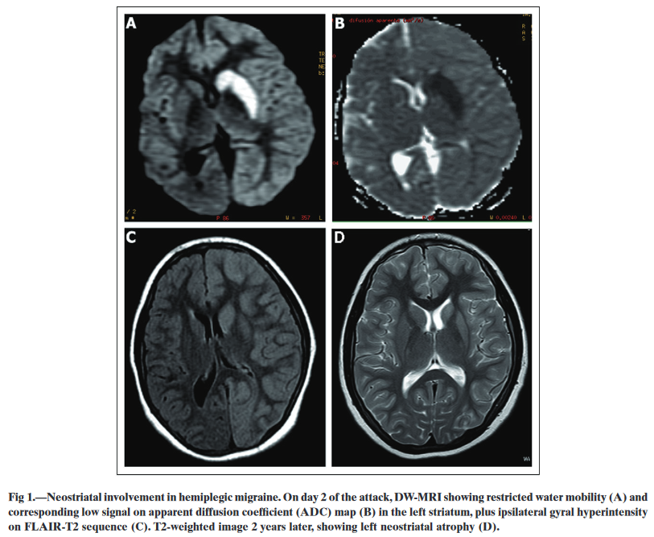
CACNA1A
Notes:
Also seen in alternating hemiplegia of childhood
Autosomal dominant subtype of migraine with aura
1st de novo CACNA1A mutation of FHM was reported in 2000
Accounts for 50% of patients with FHM

Slide 50
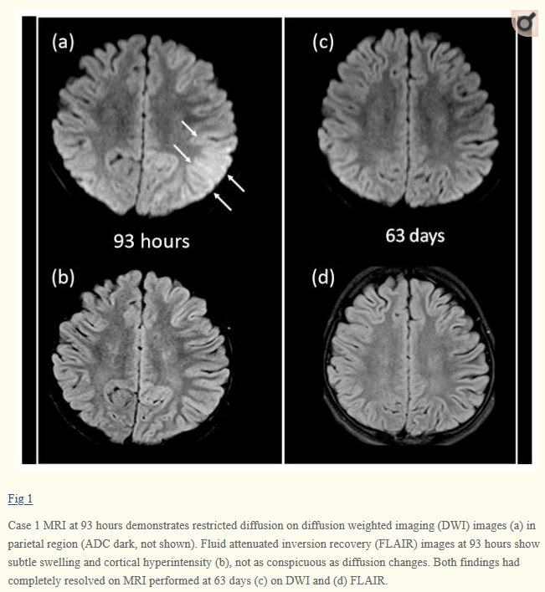
CACNA1A
Notes:
Also seen in alternating hemiplegia of childhood
Autosomal dominant subtype of migraine with aura
1st de novo CACNA1A mutation of FHM was reported in 2000
Accounts for 50% of patients with FHM

Slide 51
DWI & Edema in HM
DWI:
NOT always representative of ischemic tissue
Subtle diffusion abnormalities in HM may result from prolonged neuronal depolarization (Chabriat et al)
Significant decrease in metabolic activity seen in the involved hemisphere on FDG PET, supporting the notion of neuronal depression (Kumar et al)
Often lags clinical presentation (i.e., imaging findings present even after symptom resolution)
Edema:
Cortical swelling not limited to any discrete vascular territory.
Evidence of Energy Failure?
The transient and late restricted diffusion changes may indicate metabolic stress where neuronal cells are unable to meet energy demands, resulting in dysfunction and mild swelling of cells without ultimate neuronal cell death.
Notes:
Also seen in alternating hemiplegia of childhood
Autosomal dominant subtype of migraine with aura
1st de novo CACNA1A mutation of FHM was reported in 2000
Accounts for 50% of patients with FHM

Slide 52
Familial hemiplegic migraine
Prognosis:
For episodes with coma, can take months to recover
Cerebellar signs: seen in 20%
At risk for irreversible injury with cognitive deterioration
Blindness: peripheral to central; triggered by sudden change of light, standing, eye rubbing; retinal spreading depression
Treatment:
Topiramate
Verapamil
Ketamine
Notes:
Cerebellar signs can be present before the first attack
CACNA1A is present on Purkinje cells and can lead to cell death
Intellectual disability most likely to be diagnosed after recurrent episodes of severe episodes

Slide 53
Case 4:
CC: Almost 3 y/o boy who presents with 1 day of vomiting and ataxia without irritability
HPI: Started this morning and worsening. No speech or eye involvement. Decreased energy but not encephalopathic. Dx with HFMD 2.5 weeks ago.
6 months earlier, had several hours of ataxia after ?alcohol exposure. 2 weeks later, had a syncopal event then developed vomiting, ataxia, and encephalopathy. Workup negative. Self-resolved in 16 hrs.
Exam: As above. No weakness. Normal reflexes.
Workup: EV PCR + rectal swab, normal CSF
Treatment: Symptoms self-resolved in <24 hrs
Notes:
Ataxia present with truncal but not appendicular
Initial workup: MRI brain and EEG were normal. Basic studies including lactate and pyruvate normal. UDS negative.
Father has epilepsy
0 cells, 0 RBCs, P14, G58
Ataxia Panel with Blueprints was negative

Slide 54
Episodic ataxia
Dramatic episodes of imbalance and incoordination
Frequently triggered by exertion or stress
Notes:
Although there are 8 described clinical syndromes, only 2 have been identified in multiple families.
These patients tend to present with rather discrete episodes of dramatic worsening but can also have progressive ataxia
These particular mutations present as described as they have a high concentration in the cerebellum

Slide 55
Episodic Ataxia
 | EA1 | EA2
Duration | Seconds to minutes | Hours
Symptoms | Vertigo, dysarthria, coarse tremor, seizures | Vertigo, tonic upward gaze, dystonia, cognitive impairment, seizures, migraine
Triggers | Emotional stress, startle, abrupt movements | Exercise or stress
Interictal findings | Myokymia +/- myotonia | Nystamus, Ataxia
Genetics | KCNA1 | CACNA1A
Inheritance | AD | AD
Treatment | Carbamazepine Acetazolamide Valproic Acid | Acetazolamide
Notes:
There are 8 subtypes; however, the others have only been reported in 1-2 families each
What is myokymia?
EA2 is the MOST COMMON type. The paroxysmal tonic upgaze is present in infancy, typically before the other symptoms begin. As the tonic upgaze disappears, the chronic cerebellar symptoms begin.
KCNA1 is highly expressed in Purkinje cells. Hyper excitable, decreased GABA, seizures.

Slide 56
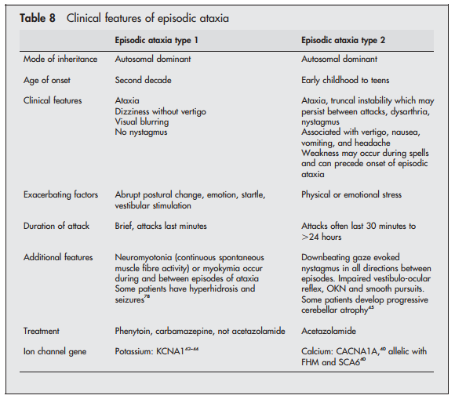
Episodic Ataxia
Notes:
There are 8 subtypes; however, the others have only been reported in 1-2 families each
What is myokymia?
EA2 is the MOST COMMON type. The paroxysmal tonic upgaze is present in infancy, typically before the other symptoms begin. As the tonic upgaze disappears, the chronic cerebellar symptoms begin.
KCNA1 is highly expressed in Purkinje cells. Hyper excitable, decreased GABA, seizures.

Slide 57
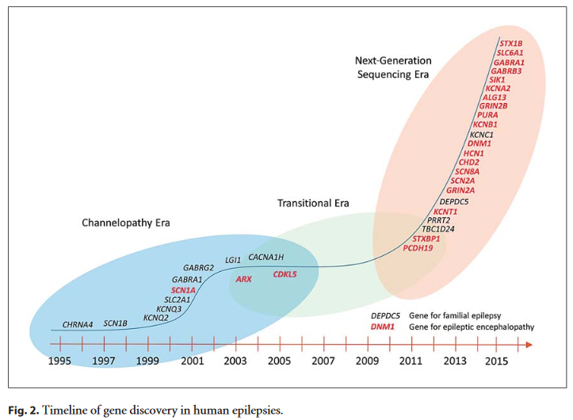
Epilepsy as Channelopathy
Notes:
Dravet: SCN1A or GABRG2 (encodes GABA receptor) – both lead to reduced excitability of GABAergic neurons leading to brain hyper-excitability. The Nav1.1 channel is preferentially expressed in GABAergic neurons

Slide 58
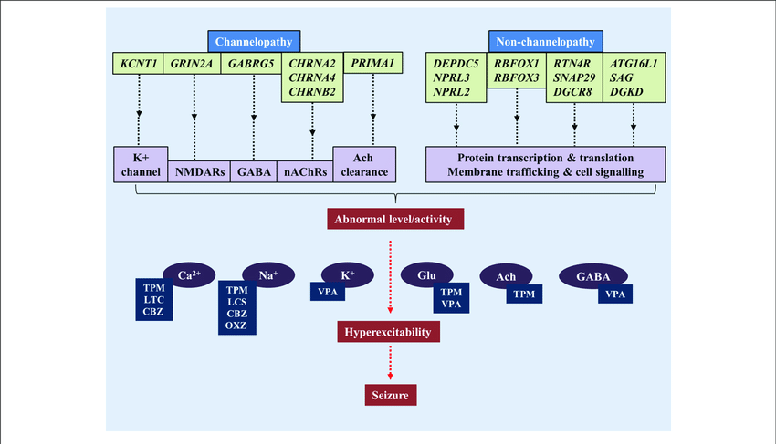
Epilepsy as Channelopathy
Notes:
Dravet: SCN1A or GABRG2 (encodes GABA receptor) – both lead to reduced excitability of GABAergic neurons leading to brain hyper-excitability. The Nav1.1 channel is preferentially expressed in GABAergic neurons

Slide 59
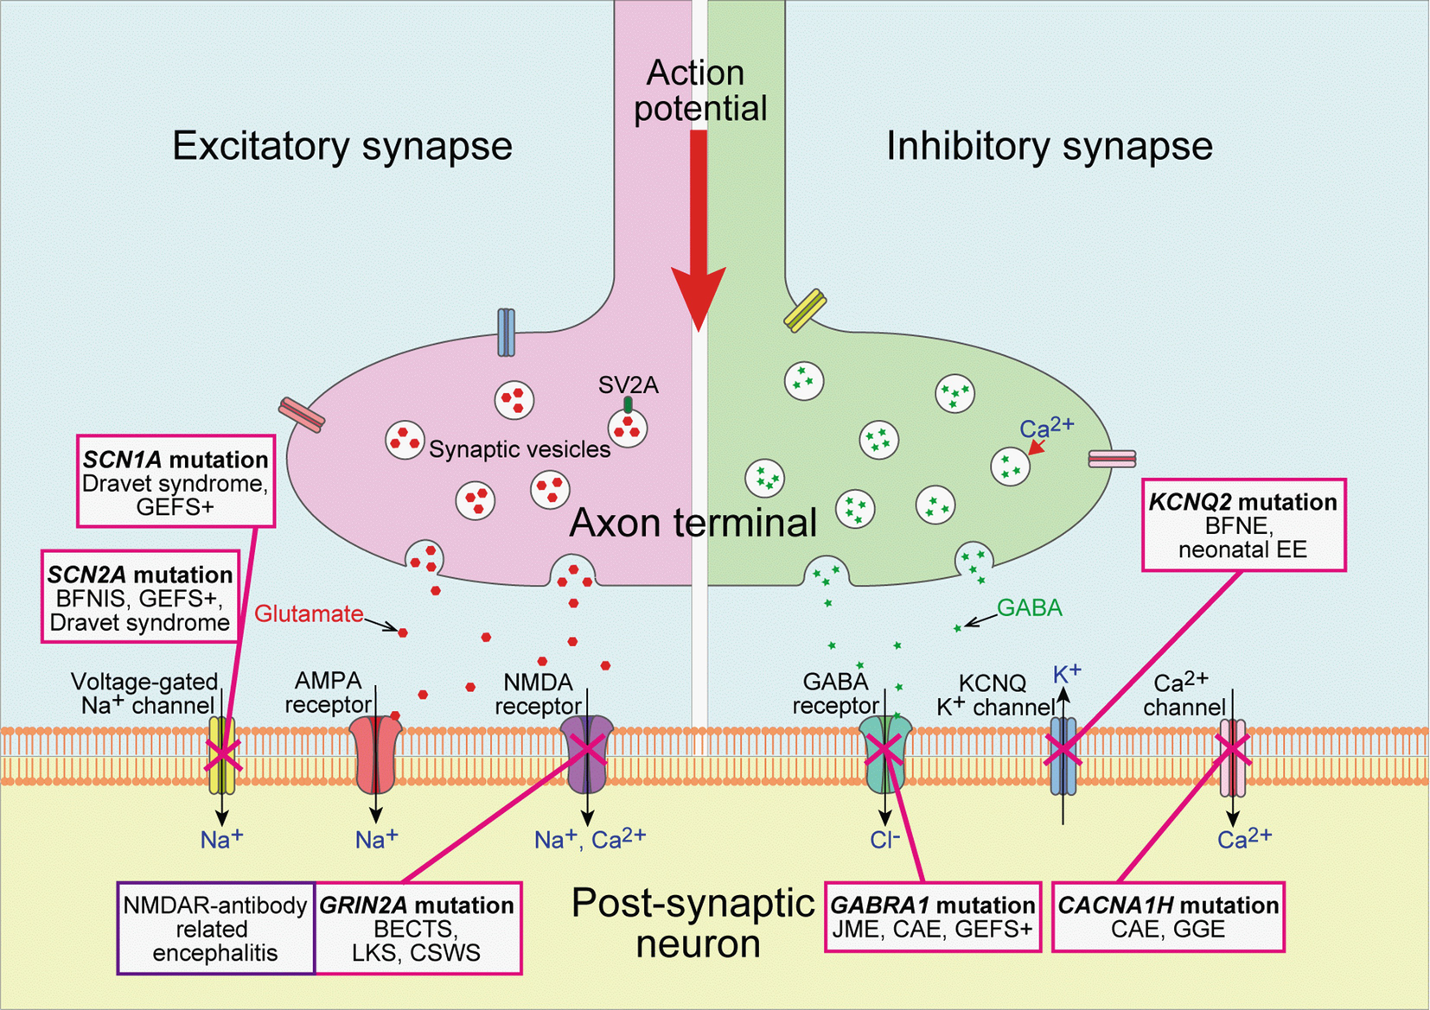
Epilepsy as Channelopathy
Notes:
Dravet: SCN1A or GABRG2 (encodes GABA receptor) – both lead to reduced excitability of GABAergic neurons leading to brain hyper-excitability. The Nav1.1 channel is preferentially expressed in GABAergic neurons

Slide 60
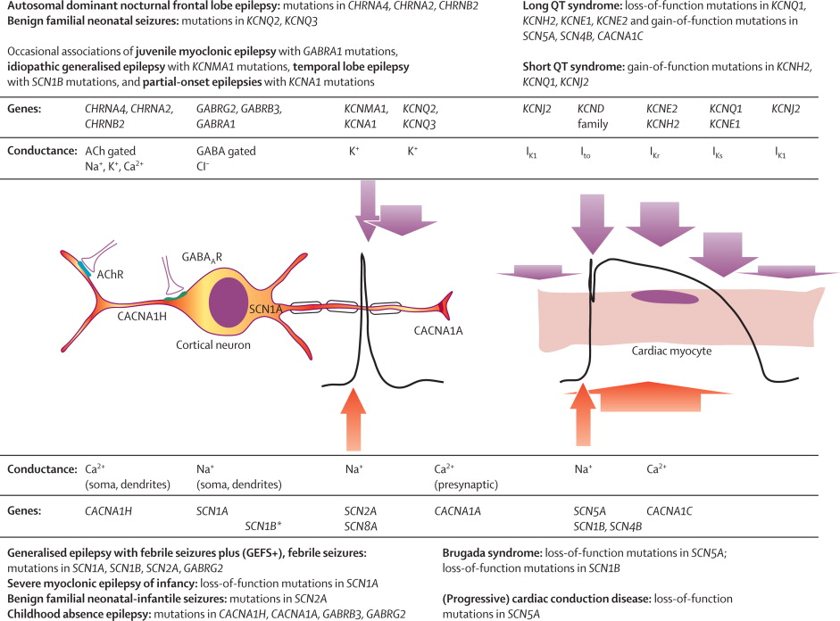
Epilepsy as Channelopathy
Notes:
Dravet: SCN1A or GABRG2 (encodes GABA receptor) – both lead to reduced excitability of GABAergic neurons leading to brain hyper-excitability. The Nav1.1 channel is preferentially expressed in GABAergic neurons

Slide 61
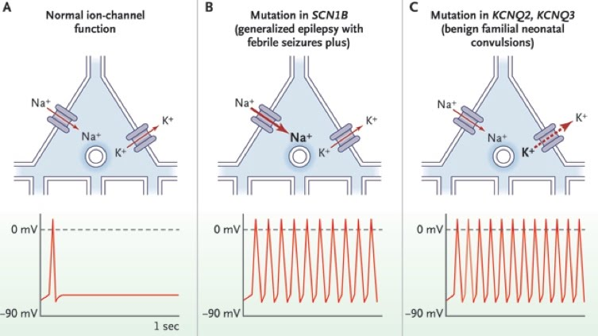
Epilepsy as Channelopathy
Notes:
Dravet: SCN1A or GABRG2 (encodes GABA receptor) – both lead to reduced excitability of GABAergic neurons leading to brain hyper-excitability. The Nav1.1 channel is preferentially expressed in GABAergic neurons

Slide 62
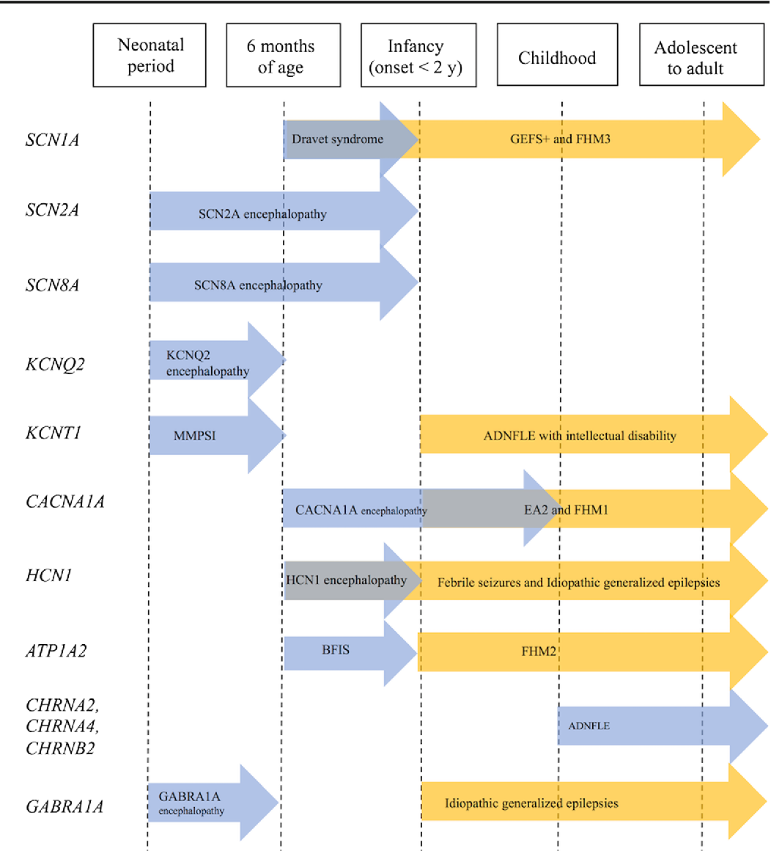
Epilepsy as Channelopathy
Notes:
Dravet: SCN1A or GABRG2 (encodes GABA receptor) – both lead to reduced excitability of GABAergic neurons leading to brain hyper-excitability. The Nav1.1 channel is preferentially expressed in GABAergic neurons

Slide 63
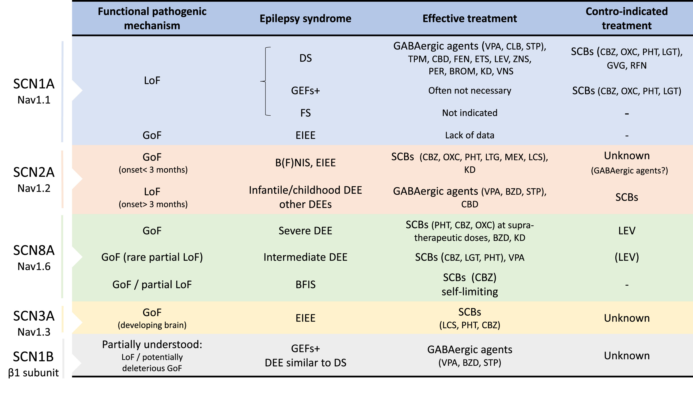
Epilepsy & Sodium Channelopathies
Notes:
Dravet: SCN1A or GABRG2 (encodes GABA receptor) – both lead to reduced excitability of GABAergic neurons leading to brain hyper-excitability. The Nav1.1 channel is preferentially expressed in GABAergic neurons

Slide 64
Epilepsy & Sodium Channelopathies
Voltage-gate sodium channels (VGSC)
Large transmembrane proteins composed of a pore-forming alpha subunit, and one or two regulatory beta subunits.
9 different alpha subunits (Na_{v}1.1 – Na_{v}1.9) are encoded by 9 different genes (SCN1A-SCN5A; SCN8A-SCN11A).
Only Na_{V}1.1, Na_{V}1.2, Na_{V}1.3 and Na_{V}1.6 are expressed in the central nervous system, with different distribution and prevalence at different stages of development
Notes:
Dravet: SCN1A or GABRG2 (encodes GABA receptor) – both lead to reduced excitability of GABAergic neurons leading to brain hyper-excitability. The Nav1.1 channel is preferentially expressed in GABAergic neurons

Slide 65
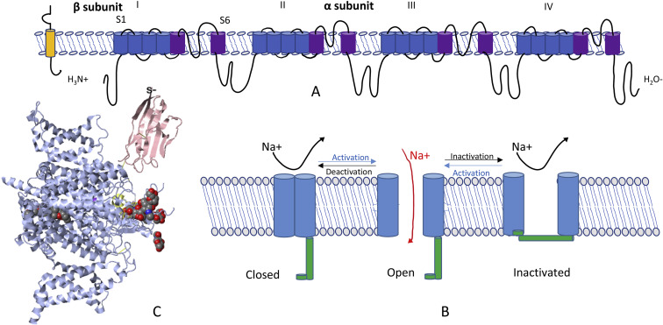
Epilepsy & Sodium Channelopathies
Notes:
Fig. 1. (A) Structure of sodium channel: A voltage-gate sodium channel (VGSC) is a large transmembrane protein composed by an alpha sub-unit (260 KDa), that is the core of the channel, and one or two auxiliary beta subunits (approximately 35 KDa) with a role on kinetic and voltage dependence of gating and cell-cell interactions. The alpha sub-unit is made from four homologous domains (I, II, III e IV) containing six transmembrane segments each (S1–S6), with a N-terminal and a C-terminal side. The re-entrant loop between S5 and S6 constitutes the pore of the channel and it is responsible for selective ion conductance. S6 segments form the inner pore and have a pivotal role in binding agents with action of sodium-blockers, which impede ions conduction. (B) Conformational states: At resting membrane potentials, VGCs are closed, blocked on the extracellular side by their activation gates. In response to membrane depolarization, they rapidly open and allow the current of ions (activation). At the peak of the action potential, VGSCs rapidly inactivate themselves by closing their inactivation gates (fast inactivation), becoming ions impermeable. The role of this transient current of sodium ions is important to ensure the action potential in excitable cells like neurons. (C): Structure of human Nav1.2-β2-KIIIA ternary complex. VGSC: voltage-gate sodium channel.

Slide 66
Epilepsy & Sodium Channelopathies: SCN1A
Pathogenic variants in SCN1A cause a spectrum of mild to severe epilepsy, most notably:
Dravet Syndrome
Genetic/Generalized Epilepsy with Febrile Seizures Plus (GEFS+)
Intractable childhood epilepsy with generalized tonic-clonic seizures (ICE-GTC)
Febrile seizures
SCN1A gene may be risk factors for a wide range of other common epilepsies, including:
Temporal Lobe Epilepsy
Idiopathic/Genetic Generalized Epilepsy (GGE/IGE)
Notes:
Dravet: SCN1A or GABRG2 (encodes GABA receptor) – both lead to reduced excitability of GABAergic neurons leading to brain hyper-excitability. The Nav1.1 channel is preferentially expressed in GABAergic neurons

Slide 67
Epilepsy & Sodium Channelopathies: SCN1A Genetics
Dravet: caused by de novo alterations in the SCN1A gene in more than 80% of patients.
Over 1,250 different disease-causing variants have been reported throughout SCN1A.
Most variants are heterozygous missense or nonsense variants.
Splice site variants, small insertions or deletions, and large exonic or whole gene deletions are also relatively common.
Most pathogenic variants in SCN1A occur in the C-terminus and in the pore loops connecting S5 and S6.
Notes:
Dravet: SCN1A or GABRG2 (encodes GABA receptor) – both lead to reduced excitability of GABAergic neurons leading to brain hyper-excitability. The Nav1.1 channel is preferentially expressed in GABAergic neurons

Slide 68
Epilepsy & Sodium Channelopathies: SCN1A Mechanism
SCN1A encodes for the alpha-1 subunit of the voltage-gated sodium channel (Na(V)1.1).
Transmembrane alpha subunit forms the central pore of the channel.
Critical to the generation and propagation of action potentials.
In some animal models, loss-of-function mutations were shown to lead to a reduction in sodium currents and impaired signaling of GABAergic interneurons of the hippocampus.
In 70-90% of cases, Dravet Syndrome is caused by a de novo mutation in SCN1A, which often leads to a non-functional protein and possibly results in haploinsufficiency.
Some SCN1A variants seem to result in a gain-of-function.
SCN1A mutations that result in GEFS+ exist in many different parts of the gene and can result in various functional effects on the SCN1A protein, predicted to cause either hypo- or hyperexcitability of the neuron.
Notes:
Dravet: SCN1A or GABRG2 (encodes GABA receptor) – both lead to reduced excitability of GABAergic neurons leading to brain hyper-excitability. The Nav1.1 channel is preferentially expressed in GABAergic neurons

Slide 69
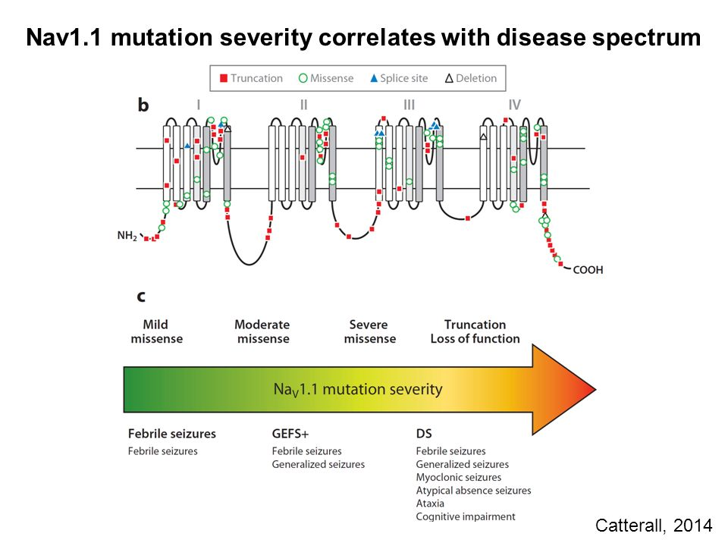
Epilepsy & Sodium Channelopathies: SCN1A Mechanism
Notes:
Dravet: SCN1A or GABRG2 (encodes GABA receptor) – both lead to reduced excitability of GABAergic neurons leading to brain hyper-excitability. The Nav1.1 channel is preferentially expressed in GABAergic neurons

Slide 70
Epilepsy & Sodium Channelopathies: SCN1A
Dravet Syndrome:
Severe childhood epilepsy with prominent fever-associated seizures.
Progresses to include other seizure types (myoclonic, partial)
Associated with progressive cognitive and behavioral deficits.
One of the most common epileptic encephalopathies caused by a single gene
Frequency of Dravet Syndrome due to variants in SCN1A is 1 in 22,000 (comparable to that of Rett Syndrome)
Notes:
Dravet: SCN1A or GABRG2 (encodes GABA receptor) – both lead to reduced excitability of GABAergic neurons leading to brain hyper-excitability. The Nav1.1 channel is preferentially expressed in GABAergic neurons

Slide 71
Epilepsy & Sodium Channelopathies: SCN1A
GEFS+
SCN1A is implicated in severe fever-related epilepsies and rare familial epilepsies
Genetic Epilepsy with Febrile Seizures Plus (GEFS+) is a milder autosomal dominant familial epilepsy syndrome.
GEFS+ phenotypes span a broad range from unaffected carriers to simple febrile seizures, febrile seizures plus, and sometimes more severe epilepsies.
Core phenotype in GEFS+ families are Febrile Seizures Plus.
refers to febrile seizures (FS) persisting beyond the age of 6 years or FS in conjunction with other, afebrile seizure types.
Simple FS is a very common phenotype within GEFS+ families, but the overall family generally does include members with FS+.
In rare cases, GEFS+ phenotypes have been found to overlap with Dravet Syndrome within a family.
Notes:
Dravet: SCN1A or GABRG2 (encodes GABA receptor) – both lead to reduced excitability of GABAergic neurons leading to brain hyper-excitability. The Nav1.1 channel is preferentially expressed in GABAergic neurons

Slide 72
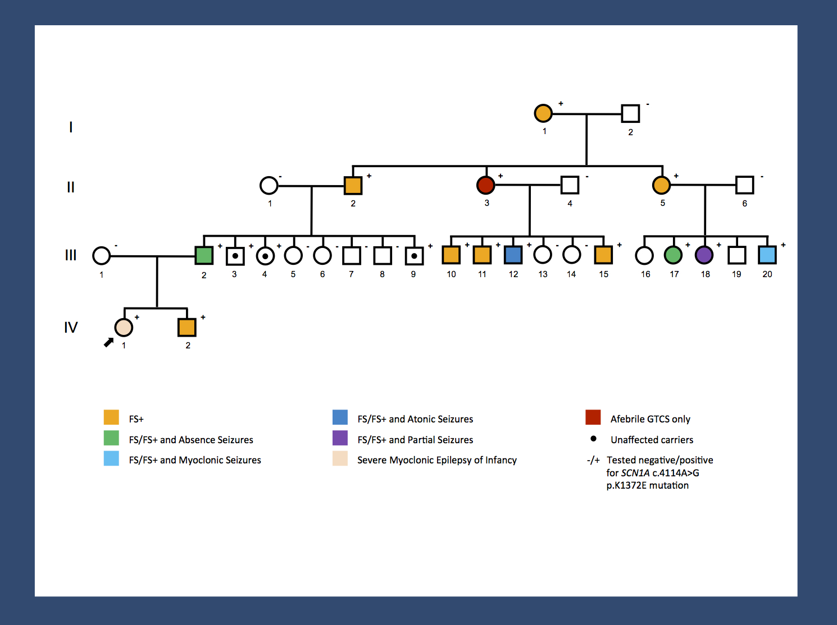
Epilepsy & Sodium Channelopathies: SCN1A
Notes:
Dravet: SCN1A or GABRG2 (encodes GABA receptor) – both lead to reduced excitability of GABAergic neurons leading to brain hyper-excitability. The Nav1.1 channel is preferentially expressed in GABAergic neurons

Slide 73
Epilepsy & Sodium Channelopathies: SCN1A
Therapy Considerations:
Seizure triggers should be avoided when possible, including hot temperatures (warm baths, exercise on hot days, untreated fever).
Cannabidiol
Stiripentol
Fenfluramine (investigative)
A number of anti-epileptic drugs are contraindicated due to side effects:
carbamazepine, lamotrigine and vigabatrin → myoclonic seizures
Phenytoin → choreoathetosis.
Notes:
Dravet: SCN1A or GABRG2 (encodes GABA receptor) – both lead to reduced excitability of GABAergic neurons leading to brain hyper-excitability. The Nav1.1 channel is preferentially expressed in GABAergic neurons

Slide 74

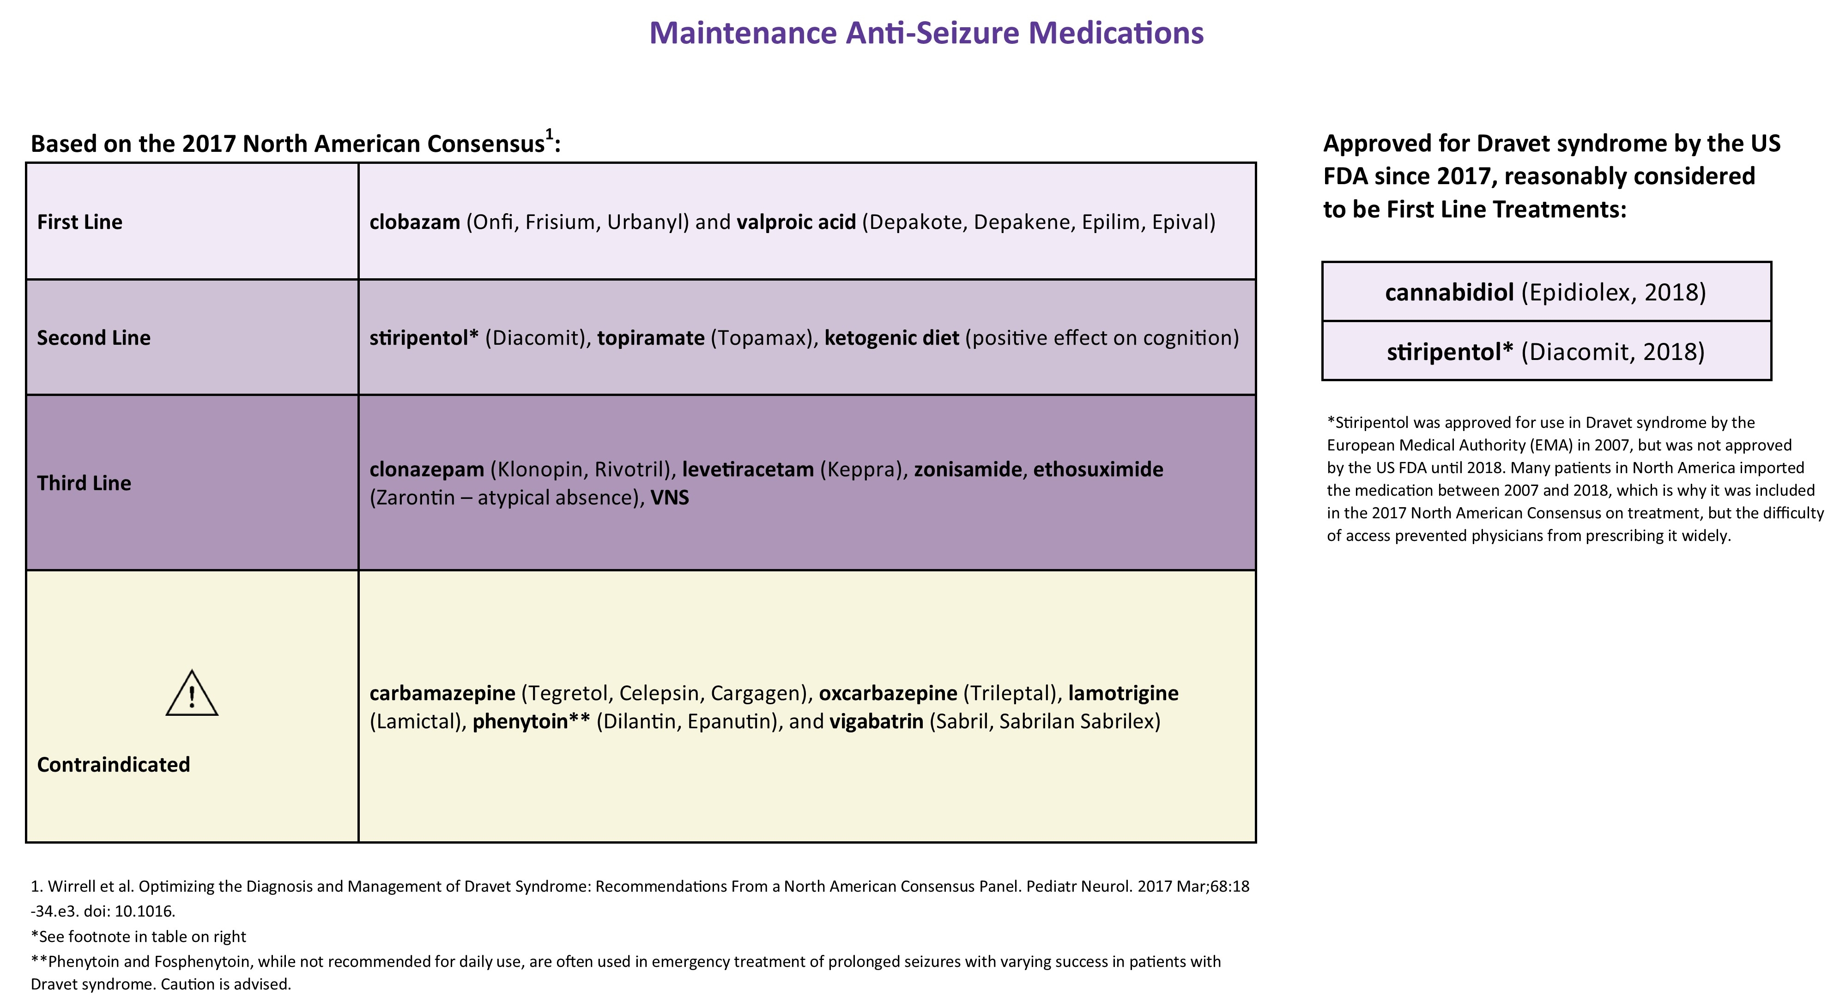
Epilepsy & Sodium Channelopathies: SCN1A
Therapy Considerations:
Seizure triggers should be avoided when possible, including hot temperatures (warm baths, exercise on hot days, untreated fever).
Cannabidiol
Stiripentol
Fenfluramine (investigative)
A number of anti-epileptic drugs are contraindicated due to side effects:
carbamazepine, lamotrigine and vigabatrin → myoclonic seizures
Phenytoin → choreoathetosis.
Notes:
Dravet: SCN1A or GABRG2 (encodes GABA receptor) – both lead to reduced excitability of GABAergic neurons leading to brain hyper-excitability. The Nav1.1 channel is preferentially expressed in GABAergic neurons

Slide 75
Epilepsy & Sodium Channelopathies: SCN2A
SCN2A-related channelopathies: one of the most common genetic causes for neurodevelopmental disorders, including epileptic encephalopathies.
SCN2A encodes an alpha subunit in a voltage-gated sodium channel and is pivotal for neuronal signaling
Predominately expressed during the first 3 months of life (partly substituted later by NAv1.6)
Phenotypic spectrum:
BFNIS
autism/intellectual disability
Schizophrenia
Infantile spasms
Severe early-onset epileptic encephalopathies
Movement disorders
Notes:
Dravet: SCN1A or GABRG2 (encodes GABA receptor) – both lead to reduced excitability of GABAergic neurons leading to brain hyper-excitability. The Nav1.1 channel is preferentially expressed in GABAergic neurons

Slide 76
Epilepsy & Sodium Channelopathies: SCN2A
Haploinsuffiency or dominant negative:
SCN2A codes for the voltage-gated sodium channel, neuronal type II, alpha subunit.
SCN2A protein is located at the axon initial segment (key structure in neurons wherein the summation of all excitatory and inhibitory inputs occurs, resulting in the firing of an action potential…or not)
Loss of function → haploinsufficiency for SCN2A → autism & intellectual disability
Some suggestion that the missense variants seen in patients with epileptic encephalopathies are activating (“gain of function”)
Though some of the BFNIS mutations have reduced cell surface expression, resulting in a net loss of SCN2A function.
Notes:
Dravet: SCN1A or GABRG2 (encodes GABA receptor) – both lead to reduced excitability of GABAergic neurons leading to brain hyper-excitability. The Nav1.1 channel is preferentially expressed in GABAergic neurons

Slide 77
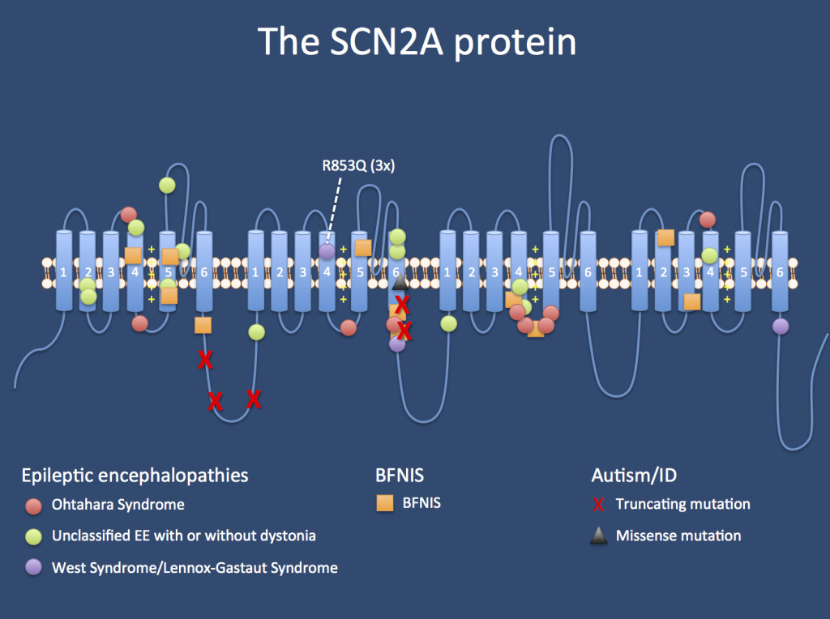
Epilepsy & Sodium Channelopathies: SCN2A
Notes:
Dravet: SCN1A or GABRG2 (encodes GABA receptor) – both lead to reduced excitability of GABAergic neurons leading to brain hyper-excitability. The Nav1.1 channel is preferentially expressed in GABAergic neurons

Slide 78
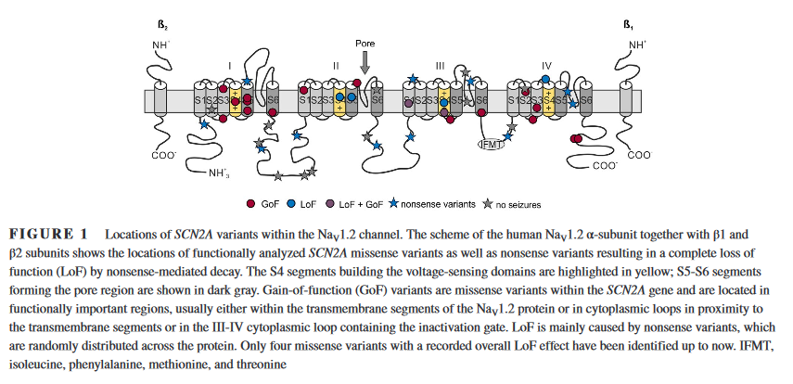
Epilepsy & Sodium Channelopathies: SCN2A
Notes:
Dravet: SCN1A or GABRG2 (encodes GABA receptor) – both lead to reduced excitability of GABAergic neurons leading to brain hyper-excitability. The Nav1.1 channel is preferentially expressed in GABAergic neurons

Slide 79
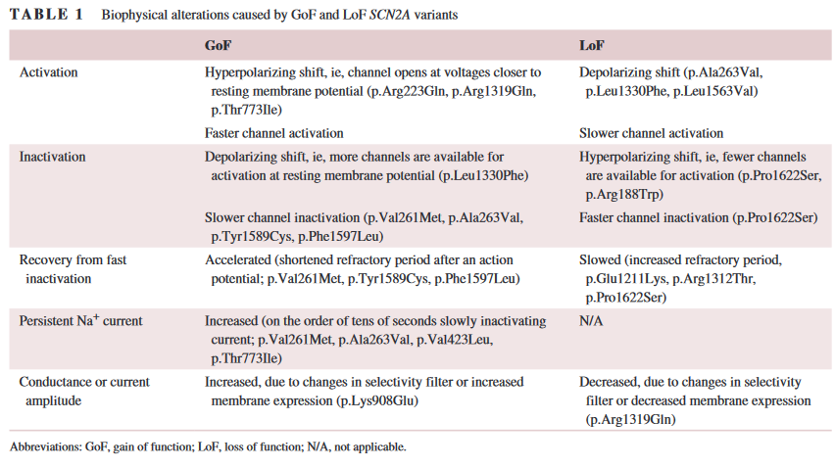
Epilepsy & Sodium Channelopathies: SCN2A
Notes:
Dravet: SCN1A or GABRG2 (encodes GABA receptor) – both lead to reduced excitability of GABAergic neurons leading to brain hyper-excitability. The Nav1.1 channel is preferentially expressed in GABAergic neurons

Slide 80
Epilepsy & Sodium Channelopathies: SCN2A
SCN2A phenotypes roughly fit into four (overlapping, i.e., not mutually exclusive) phenotypes:
Benign neonatal or infantile epilepsies
Neurodevelopmental/neuropsychiatric disorders, including schizophrenia, autism and intellectual disability
Infantile Spasms
Early onset epileptic encephalopathies, including Ohtahara syndrome, Dravet syndrome, West syndrome and severe neonatal epilepsies.
Notes:
Dravet: SCN1A or GABRG2 (encodes GABA receptor) – both lead to reduced excitability of GABAergic neurons leading to brain hyper-excitability. The Nav1.1 channel is preferentially expressed in GABAergic neurons

Slide 81
Epilepsy & Sodium Channelopathies: SCN2A
Benign familial neonatal/infantile seizures (BFNIS):
Familial syndrome of benign familial neonatal/infantile seizures was the first SCN2A phenotype to be described
Likely the least common presentation of SCN2A disorders.
Mutations were identified in large families where affected individuals had neonatal and/or infantile seizures and a normal neurodevelopmental outcome.
More commonly associated with: KCNQ2, PRRT2, SCN8A mutations.
Notes:
Dravet: SCN1A or GABRG2 (encodes GABA receptor) – both lead to reduced excitability of GABAergic neurons leading to brain hyper-excitability. The Nav1.1 channel is preferentially expressed in GABAergic neurons

Slide 82
Epilepsy & Sodium Channelopathies: SCN2A
Autism, intellectual disability, schizophrenia:
After linking SCNA mutations to BFNIS, interest re-emerged as one of the most obvious candidate genes in many neurodevelopmental disorders in large exome studies.
Several studies found de novo variants in SCN2A in patients with neurodevelopmental/neuropsychiatric phenotypes including intellectual disability, autism, and schizophrenia.
SCN2A variants associated with these conditions are usually truncating, suggesting that haploinsufficiency plays a major role.
Notes:
Dravet: SCN1A or GABRG2 (encodes GABA receptor) – both lead to reduced excitability of GABAergic neurons leading to brain hyper-excitability. The Nav1.1 channel is preferentially expressed in GABAergic neurons

Slide 83
Epilepsy & Sodium Channelopathies: SCN2A
Infantile Spasms (2-9 months)
Severe early-onset epileptic encephalopathies:
There is an entire spectrum of severe epilepsies due to pathogenic variants in SCN2A that start neonatally or within the first two months of life:
West syndrome
Ohtahara syndrome
Dravet syndrome
Unclassified epileptic encephalopathies
Treatment considerations:
Patients carrying gain‐of‐function SCN2A variants can be treated with sodium channel blockers
Notes:
Dravet: SCN1A or GABRG2 (encodes GABA receptor) – both lead to reduced excitability of GABAergic neurons leading to brain hyper-excitability. The Nav1.1 channel is preferentially expressed in GABAergic neurons

Slide 84
Epilepsy & Sodium Channelopathies: SCN8A
SCN8A encodes the voltage-gated sodium channel alpha subunit Na_{v}1.6
SCN8A was first implicated in epilepsy in 2012
Implicated in a spectrum of phenotypes:
Early infantile epileptic encephalopathies (EIEE13)
Benign infantile seizures
Paroxysmal dyskinesias
Distinguishing features of SCN8A-associated EIEE3
Movement disorders (mild ataxia, choreoathetosis, quadriplegia)
Infrequency of febrile seizures
Notes:
Dravet: SCN1A or GABRG2 (encodes GABA receptor) – both lead to reduced excitability of GABAergic neurons leading to brain hyper-excitability. The Nav1.1 channel is preferentially expressed in GABAergic neurons

Slide 85
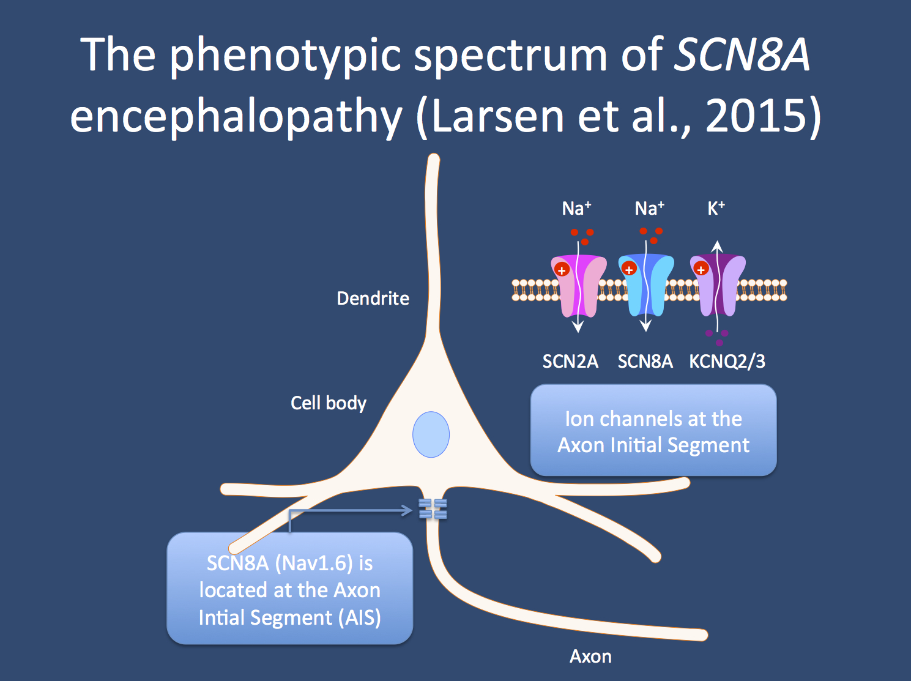
Epilepsy & Sodium Channelopathies: SCN8A
Notes:
Dravet: SCN1A or GABRG2 (encodes GABA receptor) – both lead to reduced excitability of GABAergic neurons leading to brain hyper-excitability. The Nav1.1 channel is preferentially expressed in GABAergic neurons

Slide 86
Epilepsy & Sodium Channelopathies: SCN8A
Early Infantile Epileptic Encephalopathy 13 (EIEE13)
SCN8A epileptic encephalopathy is characterized by
Seizure onset between birth and 18 months of age (mean of 5 months)
Mild to severe intellectual disability
Developmental delay with or without regression.
Seizures are frequently polymorphic. Generalized tonic-clonic seizures occur in many patients, and tonic, atonic, myoclonic, focal and absence seizures are not uncommon.
Febrile seizures are rarely observed (in contrast with Dravet syndrome).
Movement disorders (ataxia and choreoathetosis) are common and
Hypotonia, hypertonia, and/or dystonia are present in approximately half of the patients with EIEE13.
In some cases, the patients cannot sit or walk unassisted.
EEG findings in patients with EIEE13 may be normal at the time of seizure onset but often comprises moderate to severe background slowing with focal or multifocal epileptiform discharges after seizure onset.
SUDEP (sudden unexpected death in epilepsy) has been reported in 12% of cases.
Notes:
Dravet: SCN1A or GABRG2 (encodes GABA receptor) – both lead to reduced excitability of GABAergic neurons leading to brain hyper-excitability. The Nav1.1 channel is preferentially expressed in GABAergic neurons

Slide 87
Epilepsy & Sodium Channelopathies: SCN8A Genetics
Mutation Spectrum:
More than 50 mutations in SCN8A have been reported in patients with early-infantile epileptic encephalopathy (EIEE13)
Majority of variants associated with EIEE13 and benign infantile seizures and paroxysmal dyskinesia are missense variants except for one splice site mutation that causes an in-frame deletion and an intragenic deletion.
3 loss-of-function variants of SCN8A have also been associated with epilepsy.
Two missense variants caused protein instability or loss of channel activity and were associated with EIEE, and one deletion of exons 2-14 was found in a patient with early-onset absence epilepsy.
Most pathogenic mutations of SCN8A are located in the transmembrane domains of the affected protein.
Notes:
Dravet: SCN1A or GABRG2 (encodes GABA receptor) – both lead to reduced excitability of GABAergic neurons leading to brain hyper-excitability. The Nav1.1 channel is preferentially expressed in GABAergic neurons

Slide 88
Epilepsy & Sodium Channelopathies: SCN8A Mechanism
SCN8A encodes the voltage-gated sodium channel alpha subunit Na_{v}1.6
Na_{v}1.6 protein comprises 4 homologous domains that each have 6 transmembrane segments, two large intracellular loops, the inactivation gate located between D3 and D4, and intracellular N- and C-terminal domains.
The pathogenic mutations are predominantly located in the transmembrane domains, the inactivation gate, and the C-terminus. .
Na_{v}1.6 is expressed in excitatory and inhibitory neurons in the brain. Na_{v}1.6 is localized in high concentrations at the axon initial segments of neurons and at nodes of Ranvier where it mediates action potential initiation and propagation.
Hyperexcitability: Ten EIEE13-associated variants have been tested functionally.
8/10 demonstrate gain-of-function (GOF) features, including hyperpolarizing shifts in the voltage-dependence of activation, impaired inactivation, and elevated persistent current.
GOF variants of Na_{v}1.6 channel → hyperactive, → increased neuronal firing.
Neuronal hyperexcitability via GOF mutations → predominant mechanism underlying EIEE13 (Wagnon et al, 2015).
Notes:
Dravet: SCN1A or GABRG2 (encodes GABA receptor) – both lead to reduced excitability of GABAergic neurons leading to brain hyper-excitability. The Nav1.1 channel is preferentially expressed in GABAergic neurons

Slide 89
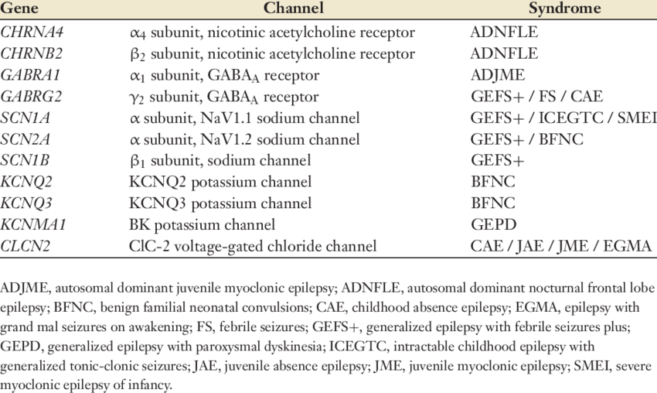
Epilepsy as Channelopathy
Notes:
Dravet: SCN1A or GABRG2 (encodes GABA receptor) – both lead to reduced excitability of GABAergic neurons leading to brain hyper-excitability. The Nav1.1 channel is preferentially expressed in GABAergic neurons

Slide 90
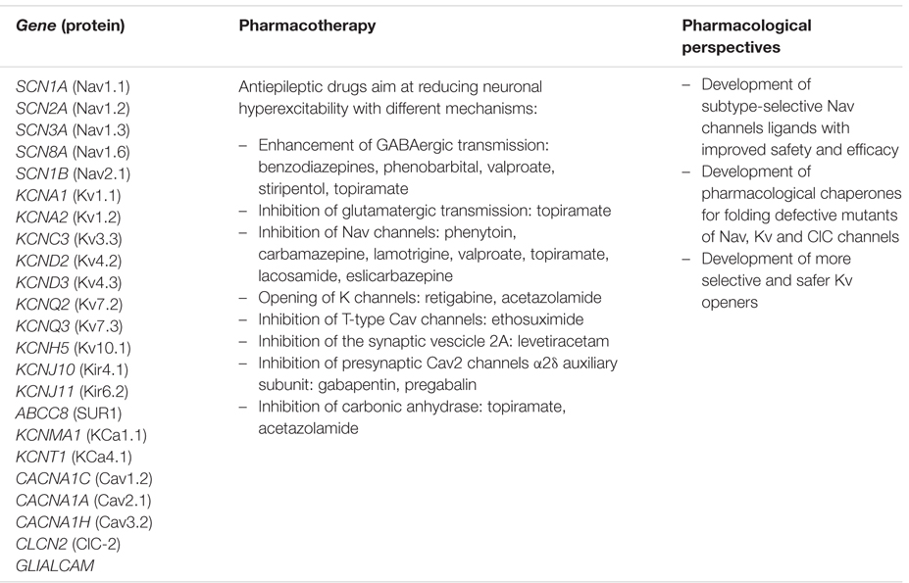
Epilepsy as Channelopathy as Pharmacologic Target
Notes:
Dravet: SCN1A or GABRG2 (encodes GABA receptor) – both lead to reduced excitability of GABAergic neurons leading to brain hyper-excitability. The Nav1.1 channel is preferentially expressed in GABAergic neurons

Slide 91
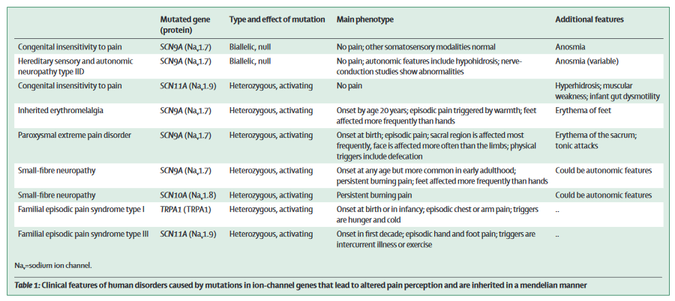
Painful & Painless Channelopathies
Notes:
Dravet: SCN1A or GABRG2 (encodes GABA receptor) – both lead to reduced excitability of GABAergic neurons leading to brain hyper-excitability. The Nav1.1 channel is preferentially expressed in GABAergic neurons

Slide 92
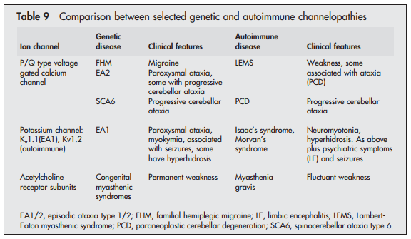
Genetic vs Autoimmune Channelopathies
Notes:
There are 8 subtypes; however, the others have only been reported in 1-2 families each
What is myokymia?
EA2 is the MOST COMMON type. The paroxysmal tonic upgaze is present in infancy, typically before the other symptoms begin. As the tonic upgaze disappears, the chronic cerebellar symptoms begin.
KCNA1 is highly expressed in Purkinje cells. Hyper excitable, decreased GABA, seizures.

Slide 93
